Slide 1
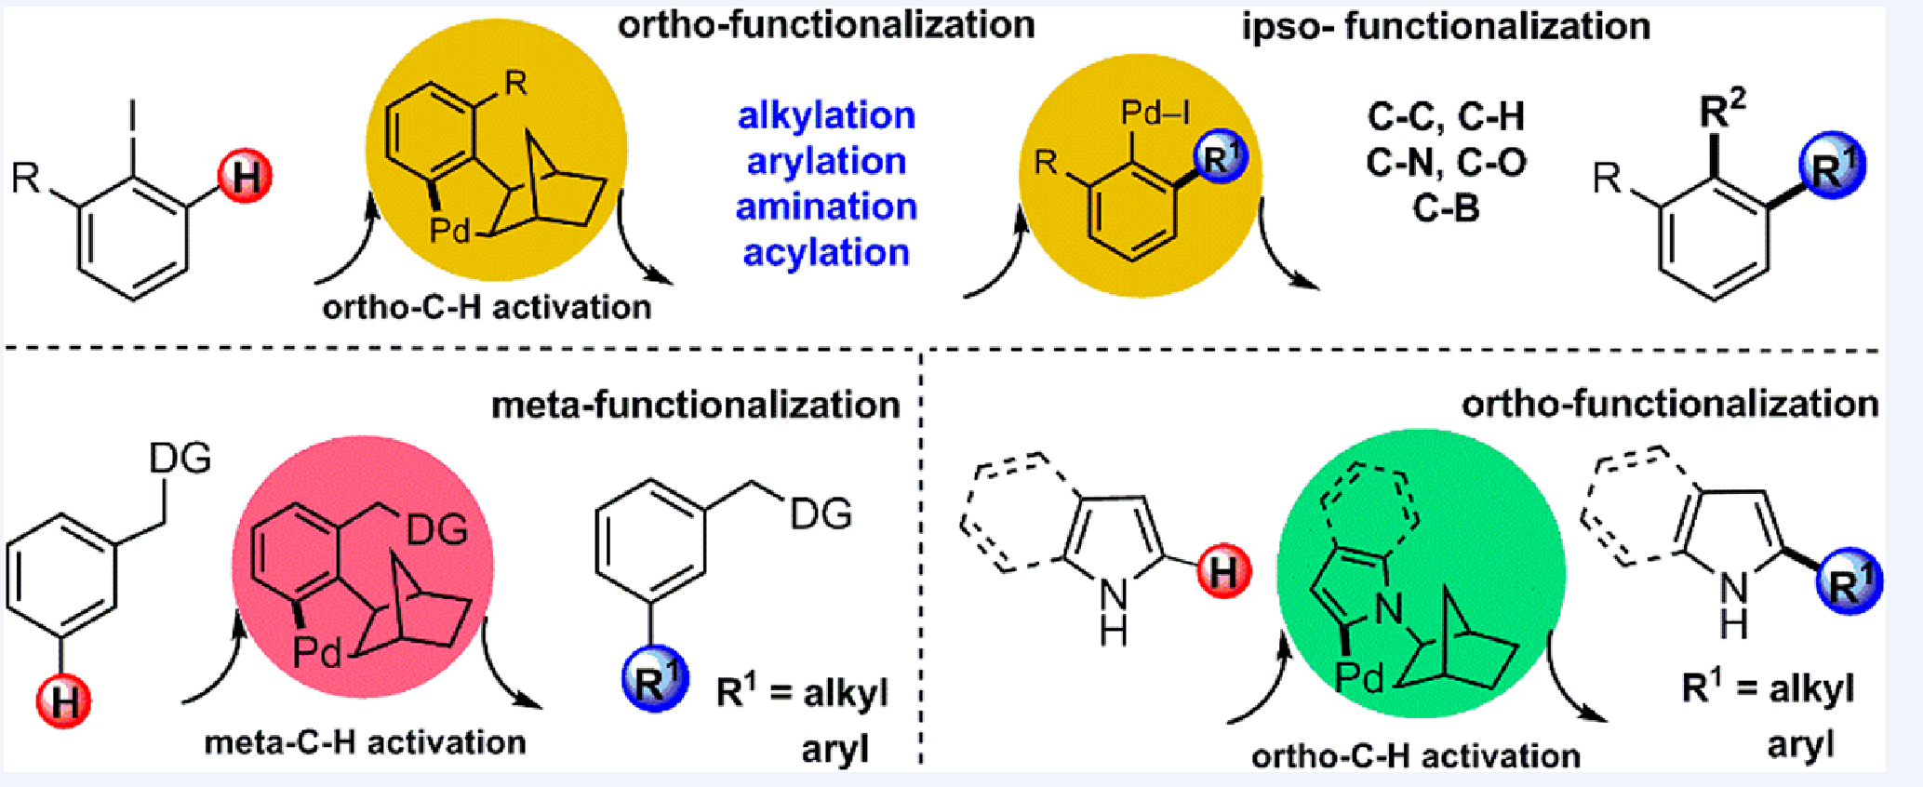
Reporter: Qinglan Liu
Supervisor: Prof. Yong Huang
2016-07-04

Slide 2
Introduction
C-H activation
avoiding the use of prefunctionalized reagents.
Challenge：
C-H bonds are ubiquitous
Selectivity, especially site selectivity, remains challenging.

Slide 3
Introduction
The feature of this system
The resulting palladacycle is extremely effective at directing the construction of complex organic molecules through sequential reactions.
This method enables the selective functionalization of both the ortho and ipso positions of aryl halides.

Slide 4
content
Aromatic alkylation;
Aromatic arylation;
Recent progress

Slide 5
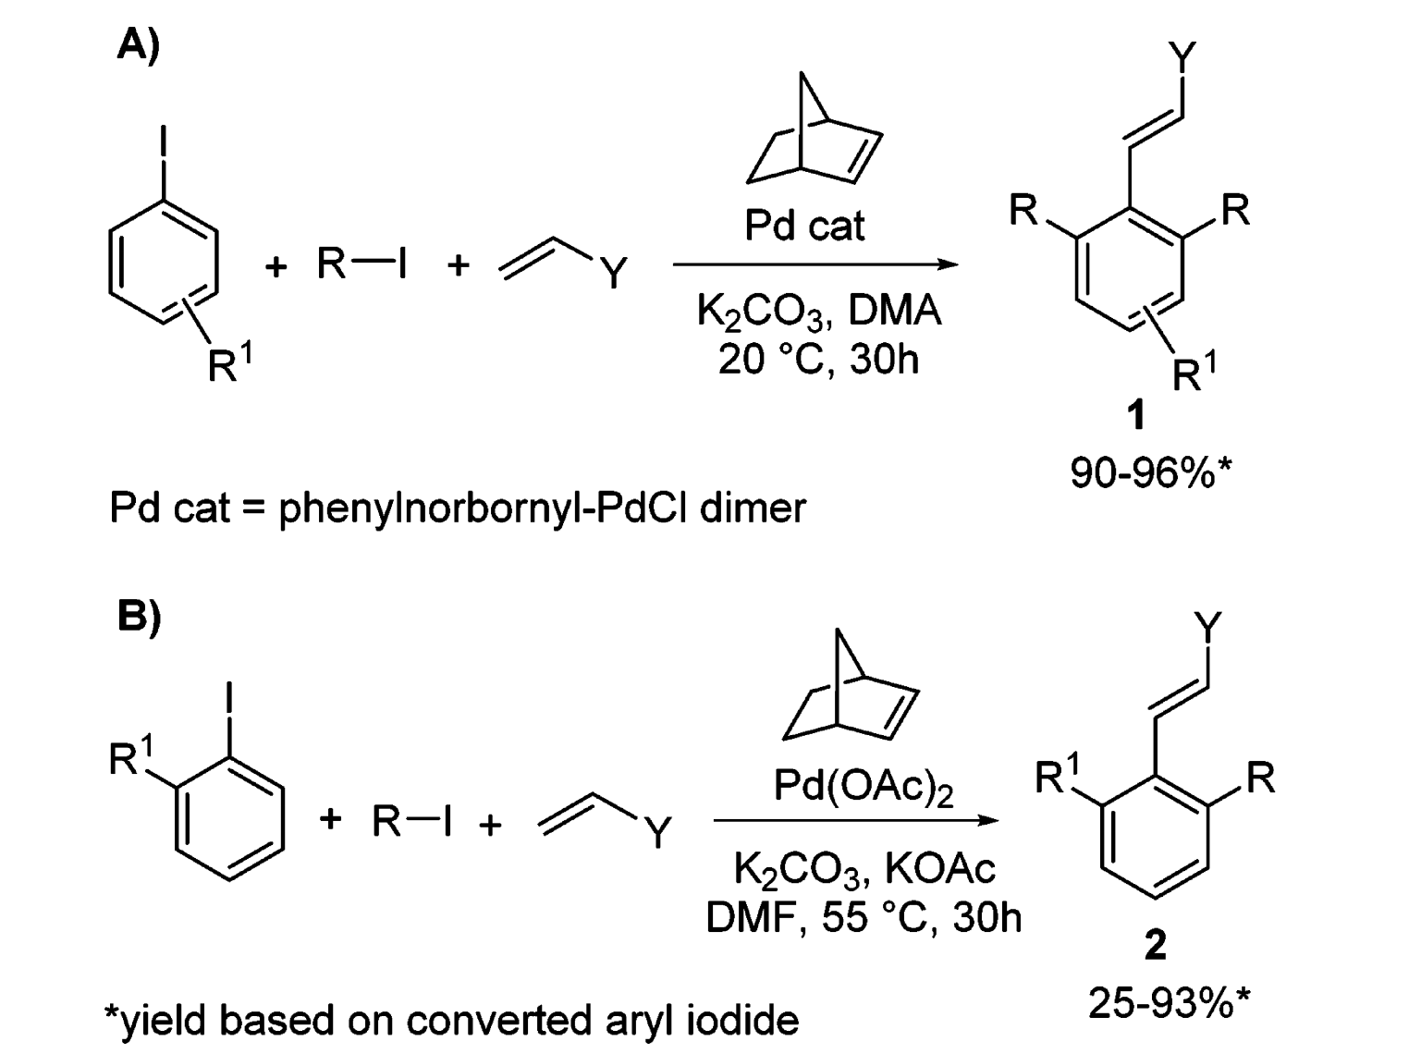
Aromatic alkylation
The initial breakthrough
Invoves the one-pot reaction;
Three C-C bonds are formed selectively
The unsymmetrical
2,6-disubstituted vinylarenes
Angew. Chem. Int. Ed. 1997, 36, 119
Tetrahedron 1999, 55, 6595

Slide 6
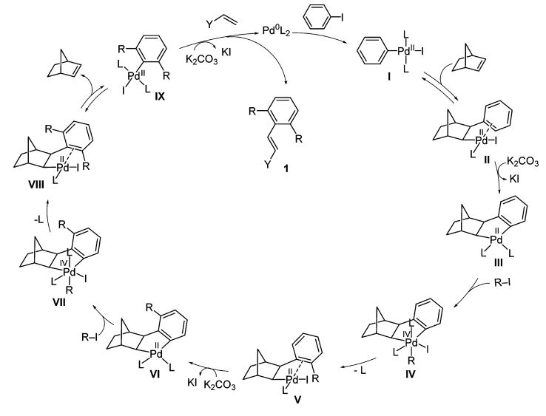
Aromatic alkylation
catalytic cycle
No β-hydrogen
elimination
The cross-coupling cascade reaction depends on the ortho-directing transient mediator, norbornene and known as Catellani reaction

Slide 7
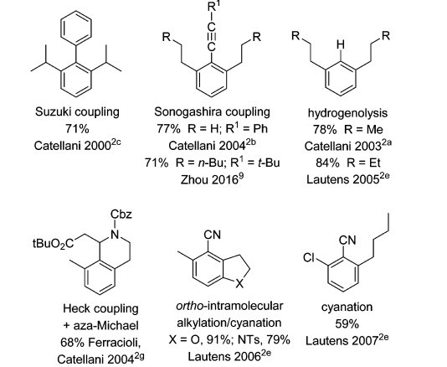
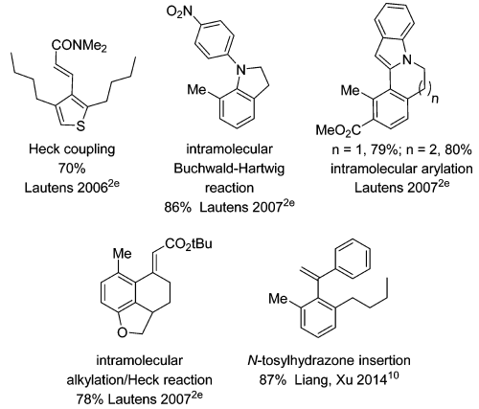
Aromatic alkylation
other partners
rapid access to multisubstituted aromatic compounds.

Slide 8
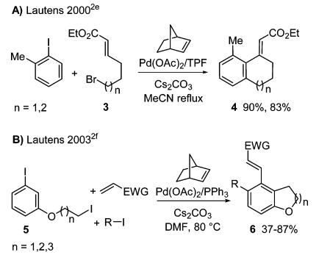
Aromatic alkylation
intramolecular process
a large variety of cyclic and polycyclic structures can be obtained.

Slide 9
content
Aromatic alkylation;
Aromatic arylation;
Recent progress
Notes:
Then is the second part: aromatic arylation;

Slide 10
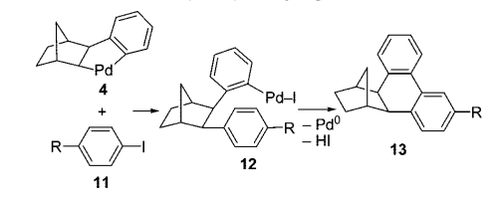
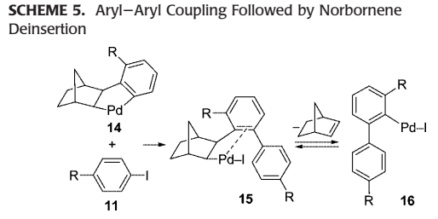
Aromatic arylation
“ortho effect”
preference to form an
sp2-sp3 C-C bond
preference to form an
sp2-sp2 C-C bond
Notes:
.

Slide 11
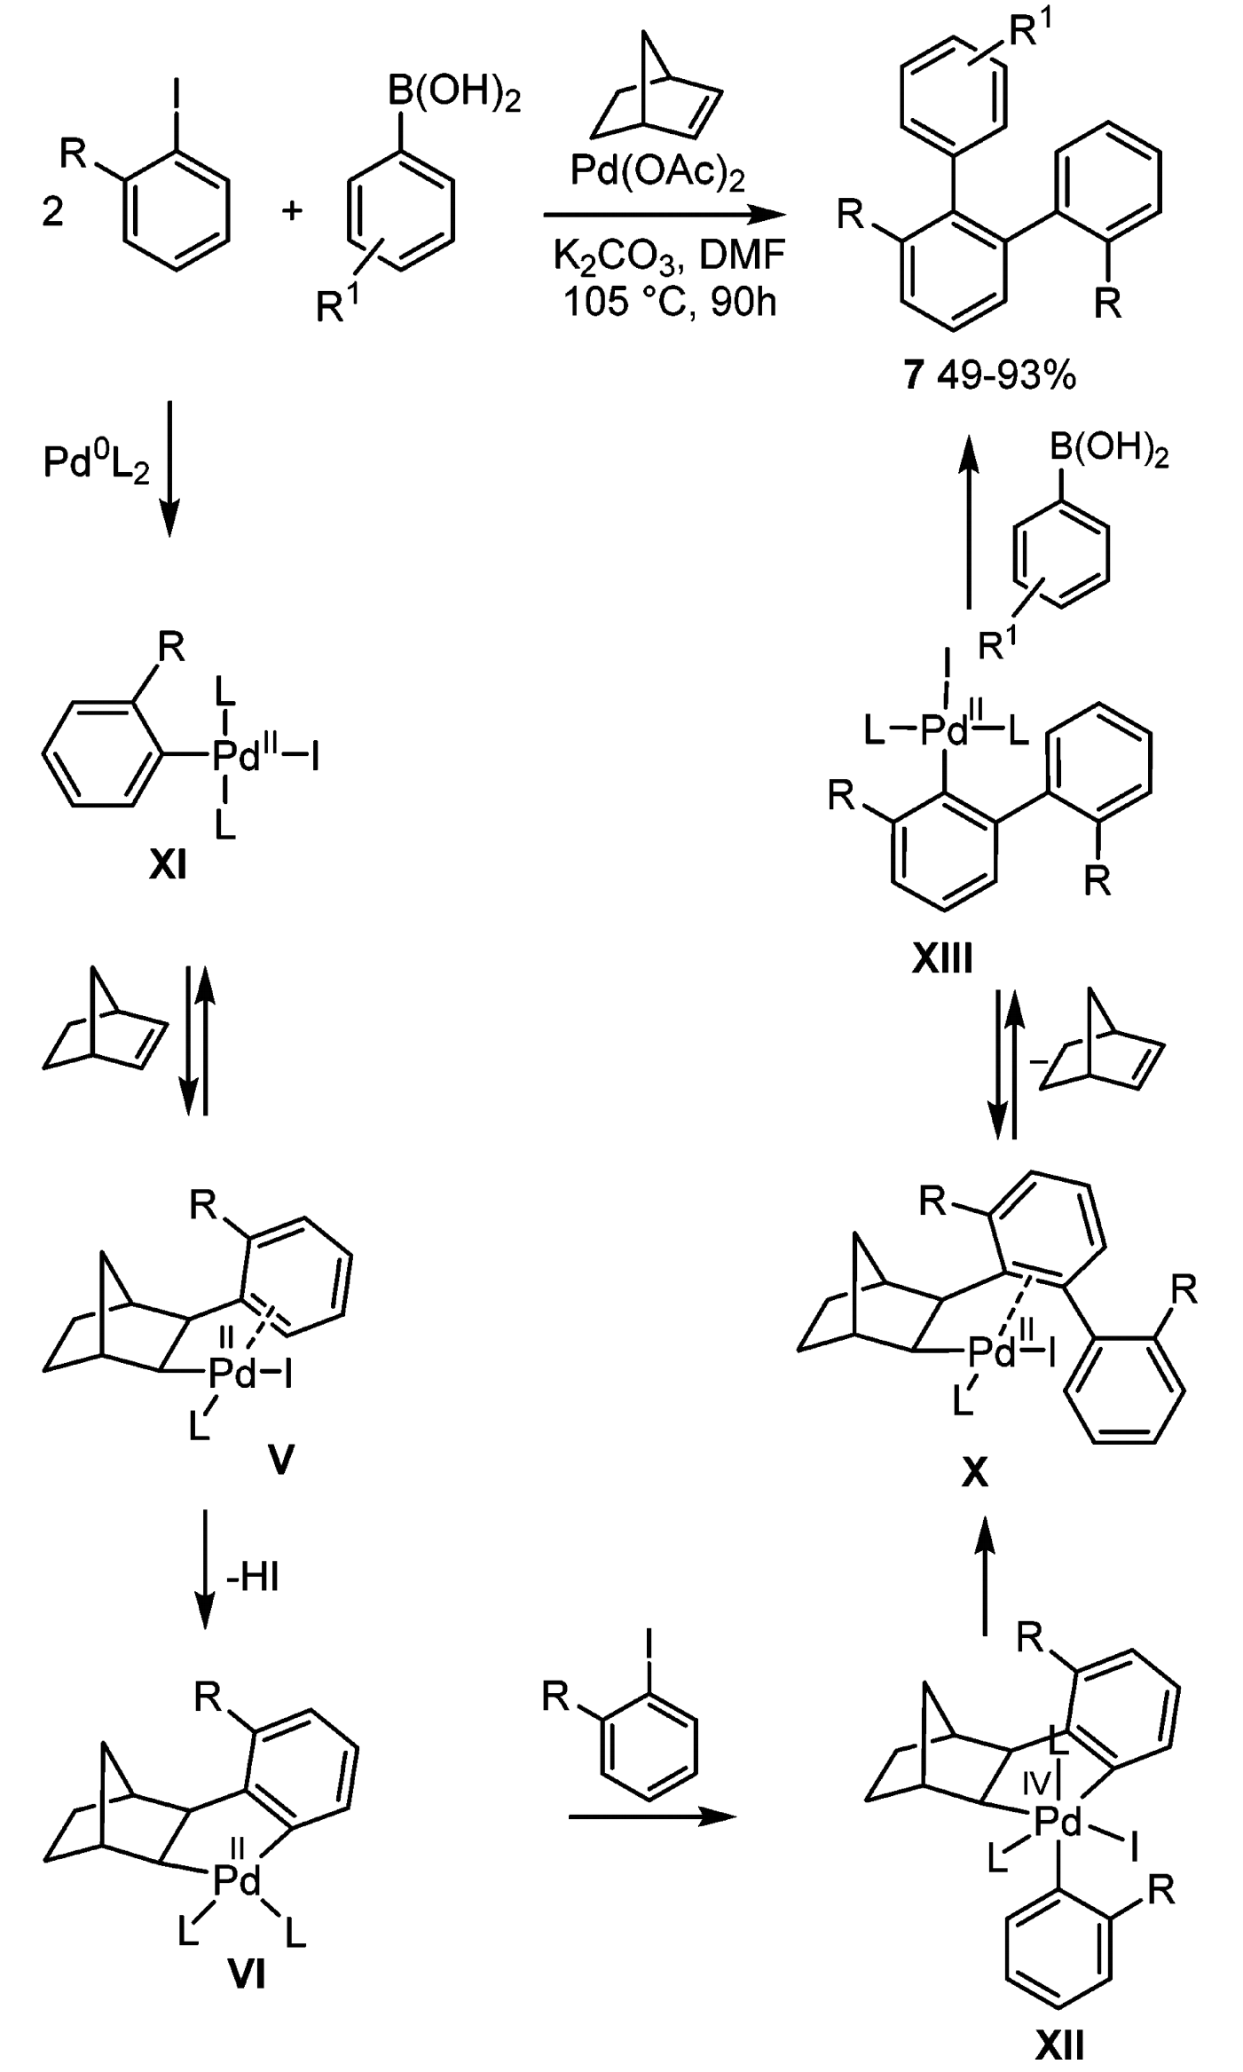
Aromatic arylation
catalytic cycle

Slide 12
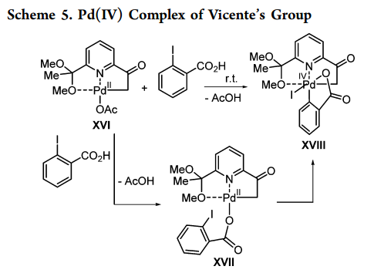
Aromatic arylation
The first aryl-Pd(IV) complex XVIII
Angew. Chem. Int. Ed. 2011, 50, 6896

Slide 13
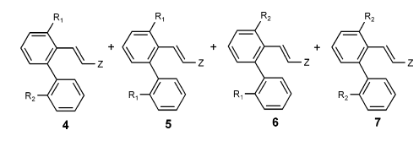
Aromatic arylation
Unsymmetrical Aryl Coupling
J. Am. Chem. Soc. 2004, 126, 78

Slide 14
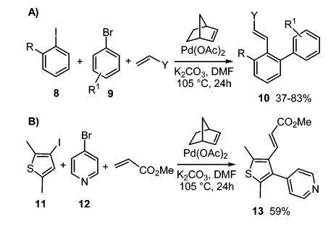
Aromatic arylation
The iodoarenes reacted faster with Pd(0) than with the Pd(II) metallacycles, and the bromoarenes preferentially reacted with
Pd(II) rather than Pd(0)
J. Am. Chem. Soc. 2004, 126, 78

Slide 15
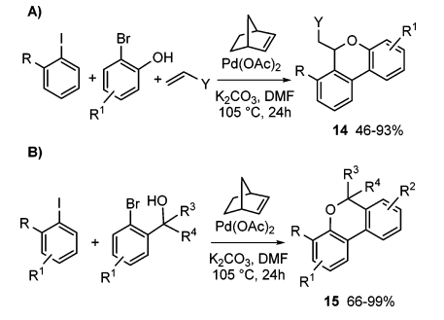
Aromatic arylation
“chelating effect”
Org. Lett. 2006, 8, 3967
dibenzopyran
“geminal group
effect”
Org. Lett. 2012, 14, 5792

Slide 16
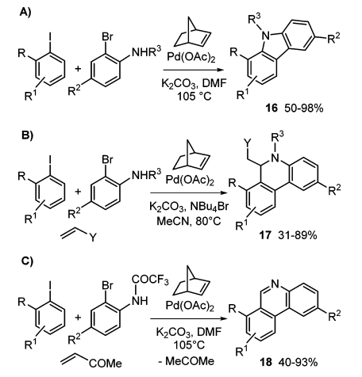
Aromatic arylation
N-protected o-bromoanilines
carbazoles
Adv. Synth. Catal. 2008, 350, 2179
dihydrophenanthridine
Adv. Synth. Catal. 2008, 350, 2513
phenanthridine
Adv. Synth. Catal. 2010, 352, 1451

Slide 17
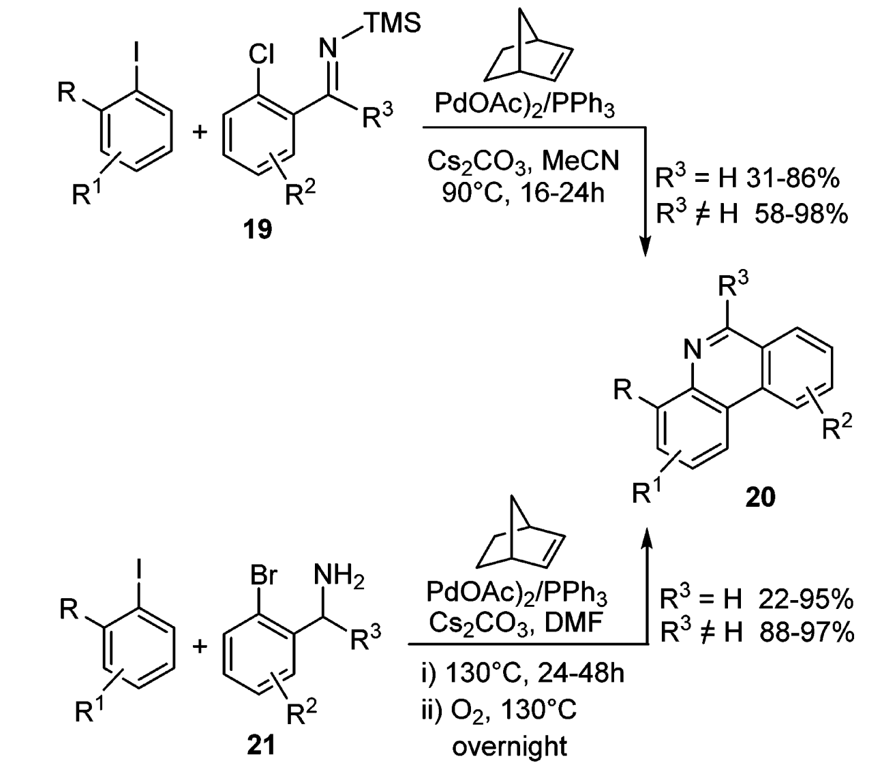
Aromatic arylation
Direct phenanthridine syntheses
Angew. Chem. Int. Ed. 2009, 48, 6713
Intramolecular amination and an oxidative dehydrogenation
No protecting group or prefunctionalization;
Dioxygen as the terminal oxidant
Org. Lett. 2010, 12, 5692

Slide 18
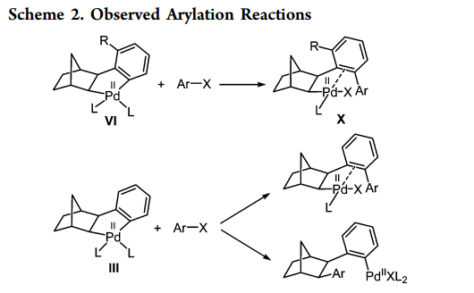
Aromatic arylation
“ortho effect”

Slide 19
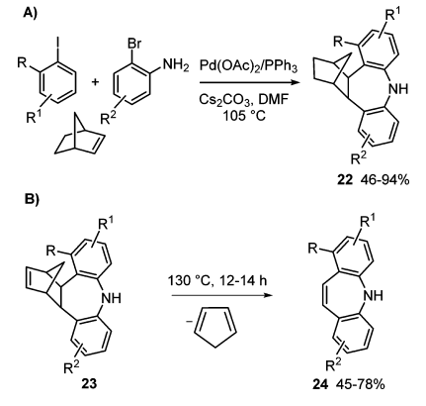
Aromatic arylation
abnormal selectivity
chelating groups are able
to offset the “ortho effect”
retro-Diels−Alder reaction
Angew. Chem. Int. Ed. 2011, 50, 12257

Slide 20
content
Aromatic alkylation;
Aromatic arylation;
Recent progress
Notes:
Finally is the third part: recent progress.

Slide 21
Recent progress
introduce an amino or an acyl group at the ortho position of aryl halides;
form a C−B bond at the ipso position;
achieve consecutive ortho and meta-C−H bond activation of aryl rings bearing a DG;
sequentially activate N−H and C−H bonds for the 2-alkylation of indoles.

Slide 22
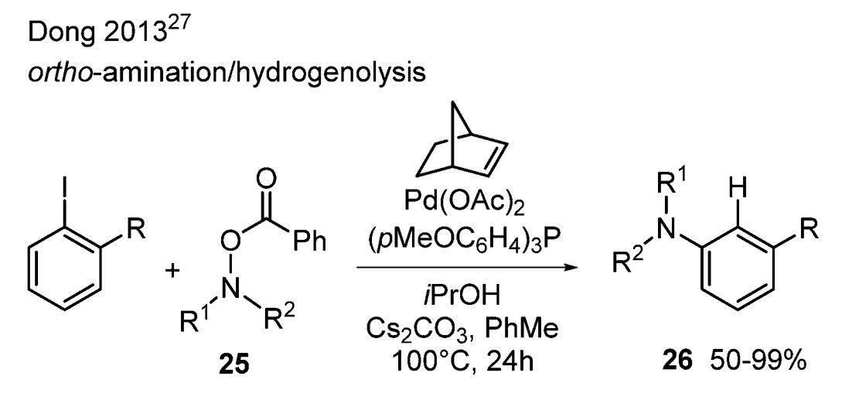
Aromatic Amination
The first Pd/norbornene catalyzed ortho-amination reaction;
Examples are provided in 50−99% yields with high functional group tolerance;
Products exclusively at the ortho-position instead of ipso;
Oxidative addition to form a Pd(IV) intermediate or direct electrophilic substitution.
J. Am. Chem. Soc. 2013, 135, 18350

Slide 23
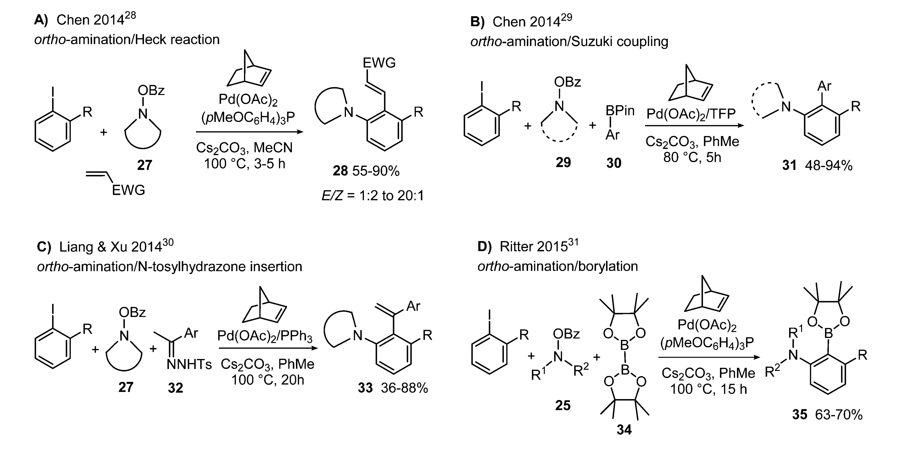
Aromatic Amination
other aromatic amination

Slide 24
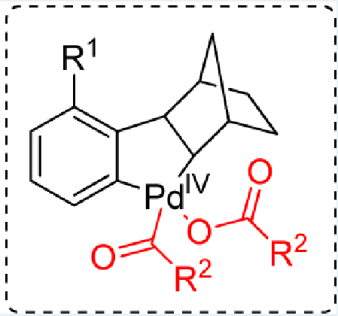
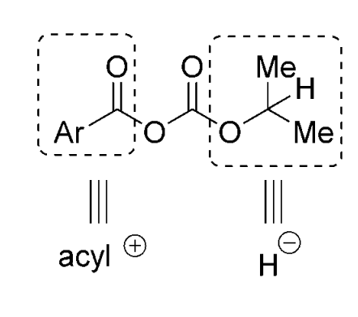
Aromatic Acylation
synthesis of aromatic ketones
the key intermediate
“bifunctional carbonate anhydride”

Slide 25
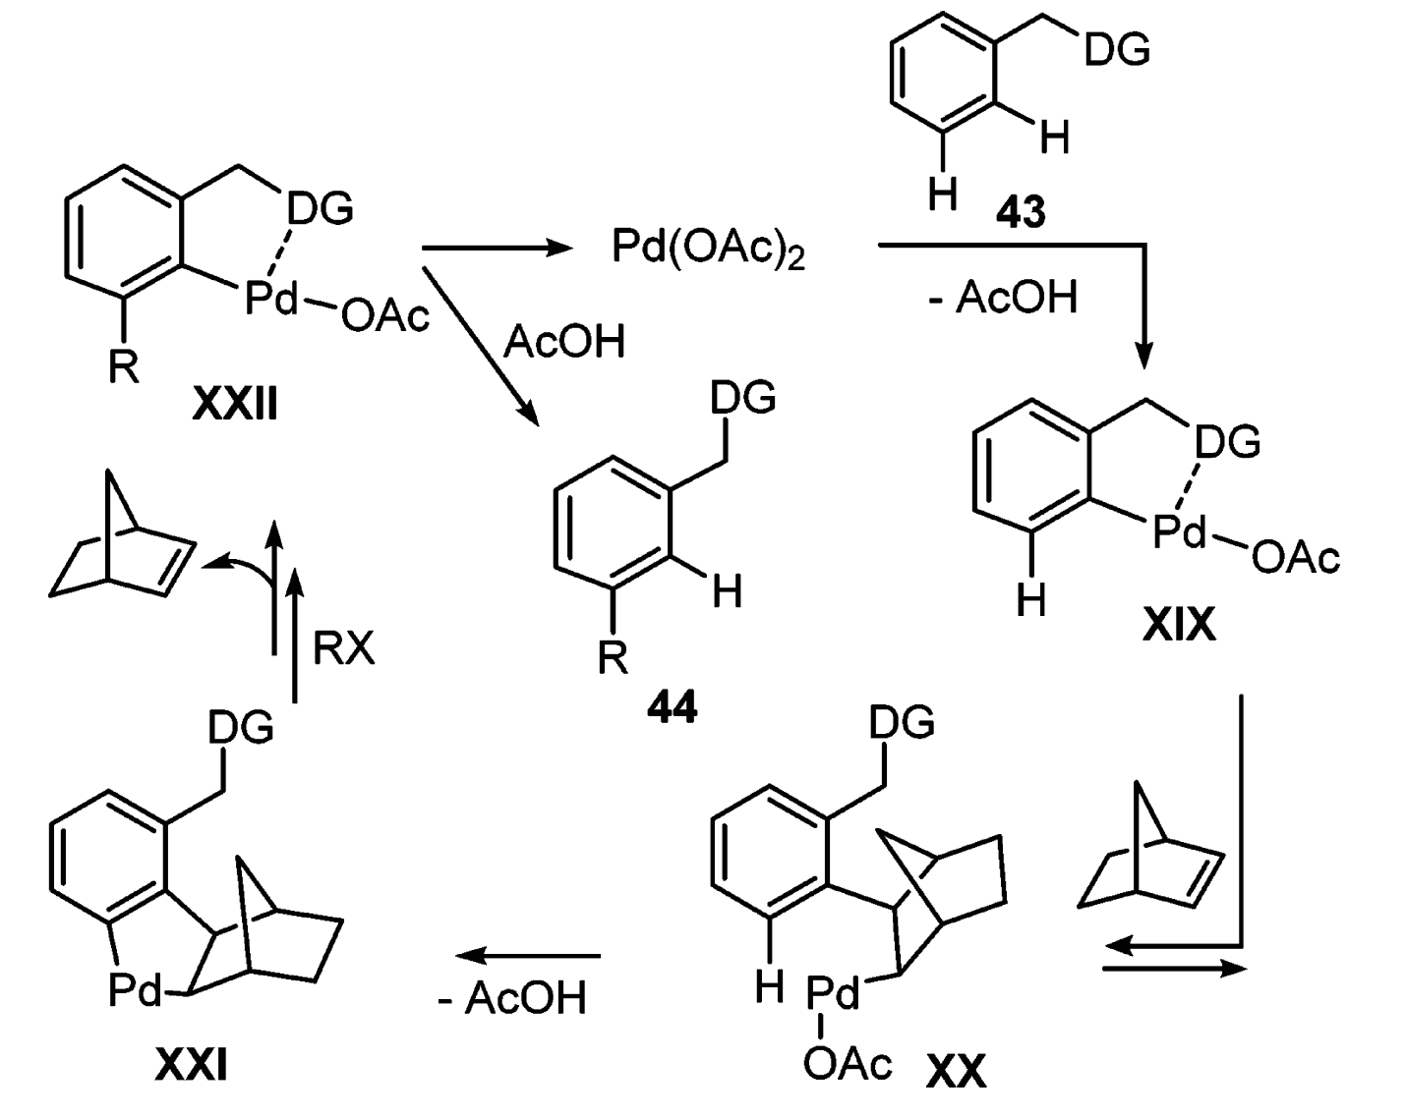
meta-Selective C−H Bond Activation
Design for meta-C−H Activation
The net result of the two consecutive ortho-C−H activation steps is meta-functionalization.

Slide 26
meta-Selective C−H Bond Activation
Yu’s work
The design of a more reactive norbornene analogue and appropriate choice of a quinoline-type ligand are crucial for
the success of this development.
Nature. 2014, 507, 215
J. Am. Chem. Soc. 2015, 137, 11574

Slide 27
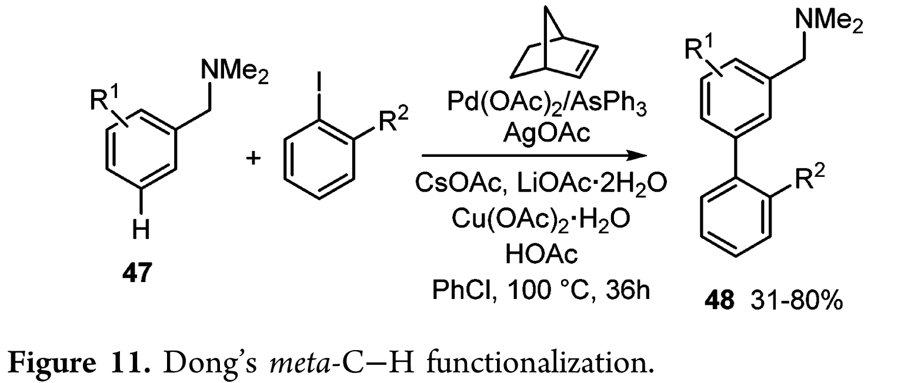
meta-Selective C−H Bond Activation
Dong’s work
simple tertiary amines as the DG;
AsPh₃ as the ligand and a unique “acetate cocktail”;
Aryl iodides with an ortho electron-withdrawing group were employed as the coupling partner;
the amine directing group can be easily installed and transformed to other common versatile functional groups.
J. Am. Chem. Soc. 2015, 137, 5887

Slide 28
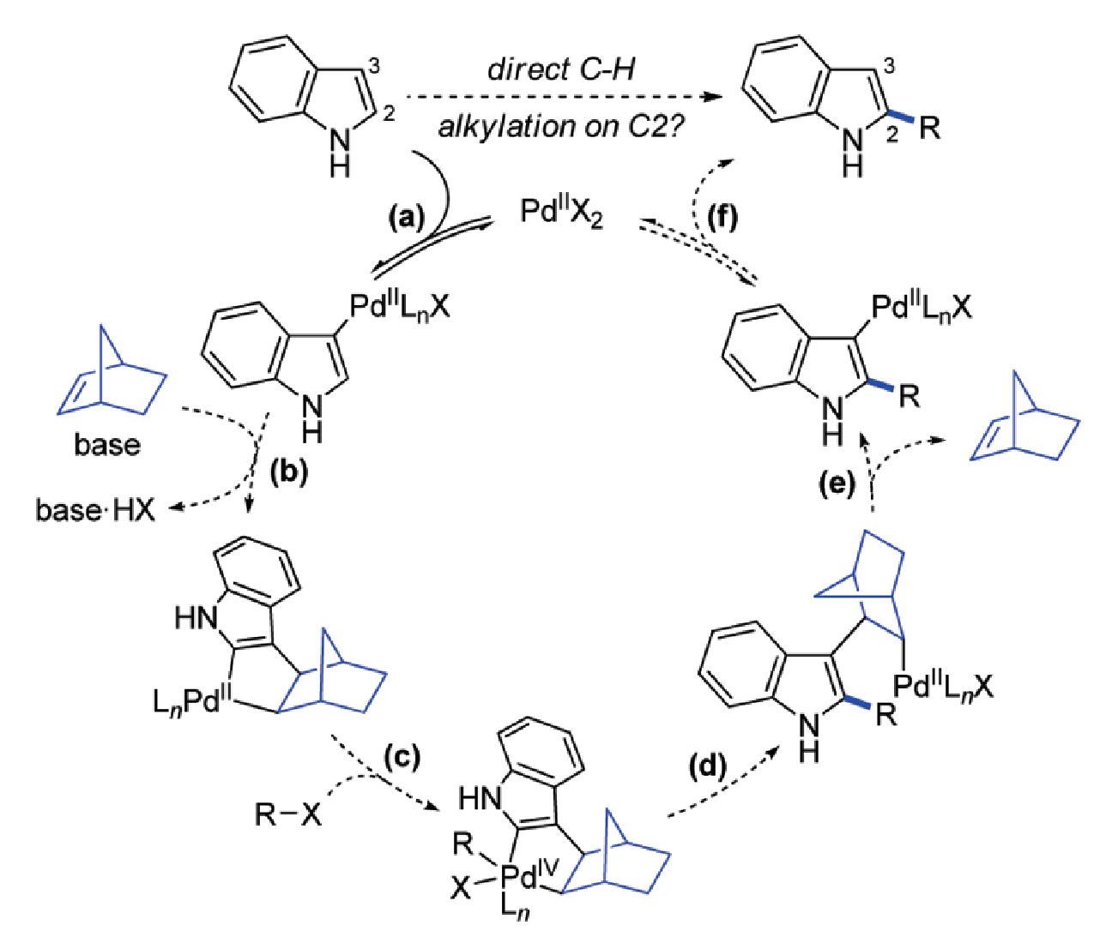
2-Alkylation of Unprotected N-Indoles
Postulated Catalytic Cycle for a Direct 2-Alkylation of Indole
a wide range of alkyl bromides
various substituents on indole
J. Am. Chem. Soc. 2011, 131, 12990

Slide 29
Summary
The Pd/norbornene combination is a unique catalytic system for selective reactions via C−H activation;
A large variety of highly functionalized aromatic compounds can be prepared in a simple and straightforward fashion through this process;
Detailed mechanistic studies are needed to gain additional insight into the reaction pathways;
Asymmetric catalysis and Pd/norbornene chemistry is the possibility of creating asymmetric sequences with exciting applications.

